Slide 1

Problem Solving Session
The remainder of today’s class will comprise the problem solving session (PSS).
Your instructor will divide you into teams of 3 or 4 students.
Each team will work together to solve the following problems over the course of 20-30 minutes.
You may work on paper, a white board, or digitally as determined by your instructor.
You will submit your solution by pushing it to GitHub before the end of class.
Your instructor will go over the solution before the end of class.
If there is any time remaining, you will begin work on your homework assignment.
Class participation is a significant part of your grade (20%). This includes in class activities and the problem solving session.
Your Course Assistants will grade your participation by verifying that you pushed your solutions before the end of the class period each day.

Slide 2

Problem Solving Team Members
Record the name of each of your problem solving team members here.
Do not forget to add every team member’s name! Your instructor (or course assistant) may or may not use this to determine whether or not you participated in the problem solving session.

Slide 3
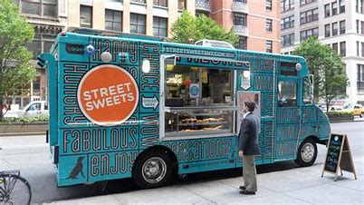
Problem Solving Problem
Today's assignment will involve creating a food ordering system for the ASCII Food Truck company. The company's motto is, 'Never leave hungry', and as such every meal they serve is a combo of a drink, entrée, and a side.
There are several options of each to choose from and they would like a system in which they can easily add new items.
The system should allow users to see the current menu and order combos. Once an order is complete it should print a receipt of the order along with the total order price.
ASCII

Slide 4
Problem 1
Each combo that our food truck sales comes with three items:
Drink
Entrée
Side
The price for each combo is based on the specific items ordered.
Define a class that can be used to store all of the relevant information.

Slide 5
Problem 2
Internally the price list will be stored using a dictionary with the food item as the key and the price as the value.
Given the following example price list:
PRICES = {'bagel':3.45, 'coffee':2.15, 'sandwich':4.25}
Write the coded necessary to answer these questions:
What is the price of a sandwich?
How much would a bagel and coffee cost?
What are all the food items for sale and their cost (use 'item: $price' format).

Slide 6
Problem 3
Ordering via the command line can be error prone. To reduce typos, the food truck uses short codes for each item. c for coffee, s for sandwich, b for bagel, etc. These codes are stored in a dictionary.
CODES = {'c':'coffee', 'b':'bagel', 's':'sandwich'}
Using the codes the user enters, write python code to determine how much an order of 's' and 'c' costs?
Note: You will need to make use of the PRICES dictionary from Problem 1 as well.

Slide 7
Problem 4
Assume the function order_combo has already been written and returns a combo order. Write a function take_order that asks the customer if they want to order a combo. The function should continue to ask as long as the customer says yes.
When done, the function should return a list of all the combo's in the order.

